Slide 1
ADVANCED DRIVING SCHOOL MANAGEMENT SYSTEM
PROJECT MEMBERS :-
Bhavik Wadiya.
Abhilasha Kondekar.
Aboli Cholachgudd.
Aditi Talgulkar.
Aishwarya Chougule.
Anusha K S.
Aswin K Kumar.
Atharva Borale.
Baseerahmad Naragund.
Besta Sarala.

Slide 2
ABSTRACT
The purpose of Advanced Driving School Management System is to automate the existing manual system by the help of computerized equipment's and full-fledged computer software, fulfilling their requirements, so that record keeping more productive and recover information quickly.
Advanced Driving School Management System, as described above, can lead to error free, secure, reliable and fast management system.
The aim of this project is to develop and implement an online driving school management school system that will useful to our driving institutions using the web.

Slide 3
INTRODUCTION
This Advanced Motor Driving School Management system can reduce the efforts of human power and wealth very much and ensure driving-training school’s information resource to be utilized effectively.
The motor driving trainers must handle several students at a time. This will provide drawback in terms of communicating with students for his or her driving category schedule or test. It is a web-based application for maintaining records of car and bike(2-wheeler and 4-wheeler) training school.
This application automates manual tasks by managing all records of student’s admission, Attendance, vehicles, and trainers.

Slide 4
TECHNOLOGY USED
Front-End :Angular
Server-side: Spring Boot
Back-end: MYSQL, Hibernate
Server: Tomcat 9.0

Slide 5
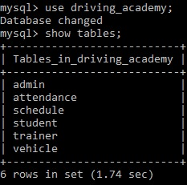
MySQL Database Tables
Student
Admin
Trainer
Attendance
Schedule
Vehicle

Slide 6
ER DIAGRAM
Student
Attendance
id : int
name : varchar(255)
admission_date : varchar(255)
training_type : varchar(255)
location : varchar(255)
age : int
username : varchar(255)
password : varchar(255)
aid : int
attendance : varchar(255)
date : varchar(255)
student_id : int
id : int (Primary key)
name : varchar(255)
password : varchar(255)
Admin
Many-to-one
Many-to-one
vid : int
brand : varchar(255)
model : varchar(255)
type :varchar(255)
tid : int
location : varchar(255)
name : varchar(255)
vid : int
sid : int
time : varchar(255)
student_id : int
trainer_tid : int
Vehicle
Trainer
Schedule
One –to-one
Many-to-one

Slide 7
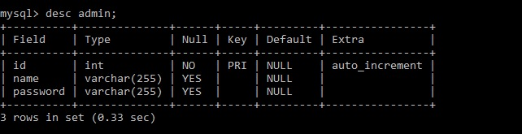
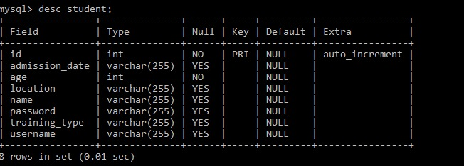
MySQL Database Tables
Admin Table
Student Table

Slide 8
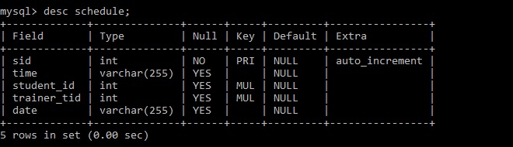
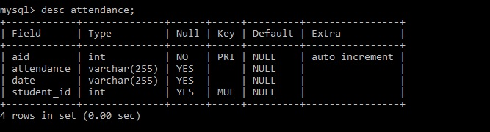
MySQL Database Tables
Schedule Table
Attendance Table

Slide 9
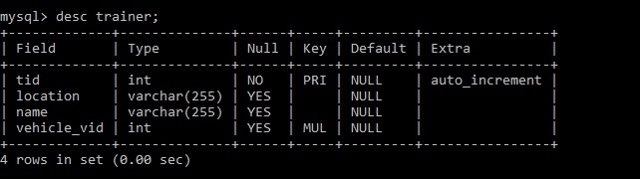
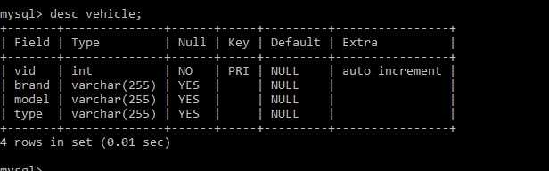
MySQL Database Tables
Trainer Table
Vehicle Table

Slide 10
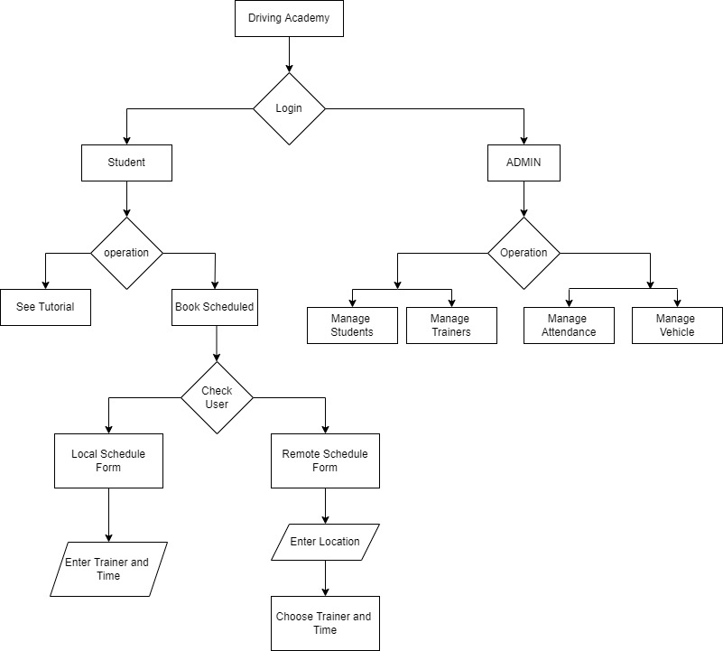

Slide 11
Junit Testing
What is the use of JUnit testing?
JUnit testing is used to test the behaviour of methods inside classes we have written. We test a method for the expected results and sometimes exception-throwing cases—whether the method is able to handle the exceptions in the way we want.
Junit is used for which type of testing? JUnit is a Java unit testing framework that's one of the best test methods for regression testing. An open-source framework, it is used to write and run repeatable automated tests

Slide 12
Functional Testing
What is postman ?
Postman is a computer application used for API testing. Postman sends an API request to the web server and receives the response,
Functional API Testing
API, or application program interface, is a system of communication methods that gives developers and non-developers access to programs, procedures, functions and services.
The most common protocol used in API is HTTP, together with REST architecture.
Popular frameworks for developing APIs include Swagger, WADL and RAML. Ideally when programming, developers form a “API Contract”, which describes how the services developed in the APIs should be consumed.

Slide 13
Start
Admin Login Page
Admin Login Page
Student
Trainer
Attendance
Vehicle
Admit New Student
Add Trainer
Mark Attendence
Add Vehicle
Id
Name
Location
Age
Admission Date
Training Type
User Name
Password
Actions
Trainer I’d
Name
Location
Vehicle_vid
Attendance id
Student id
Student name
Date
Attendance
V Id
Brand
Model
Type

Slide 14
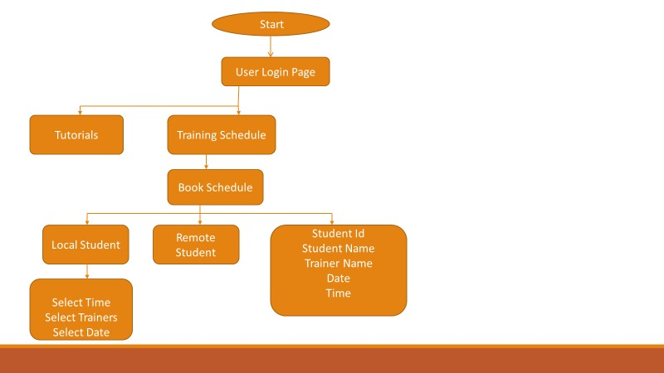
User Login Page

Slide 15
CONCLUSION
This Advanced Motor Driving School Management system is web-based application for maintaining records of driving school.
This application automates manual tasks by managing all records of student’s admission, Attendance, vehicles ,and trainer.
It can reduce the efforts of human power and wealth very much and ensure driving-training school’s information resource to be utilized effectively.

Slide 16
THANK YOU

